Slide 1
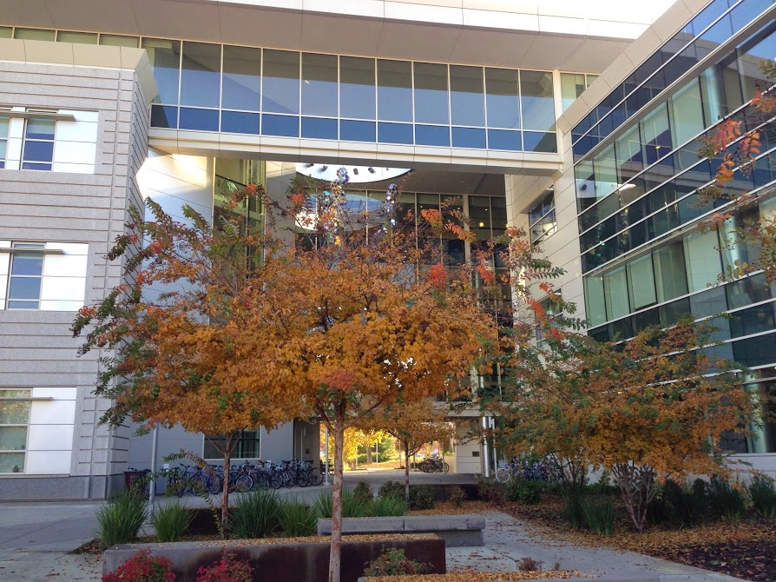
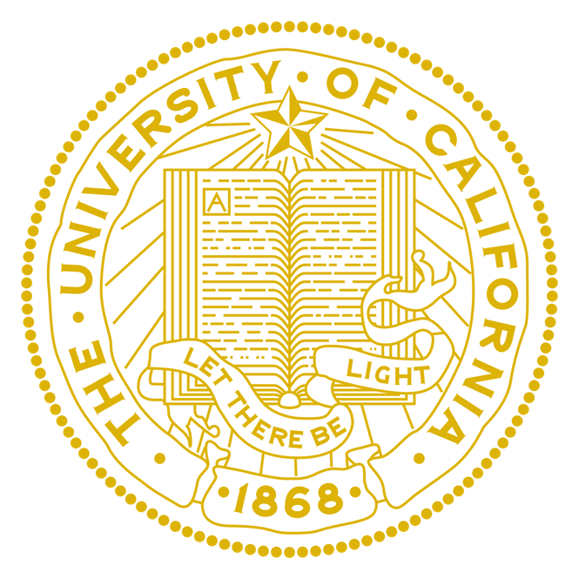


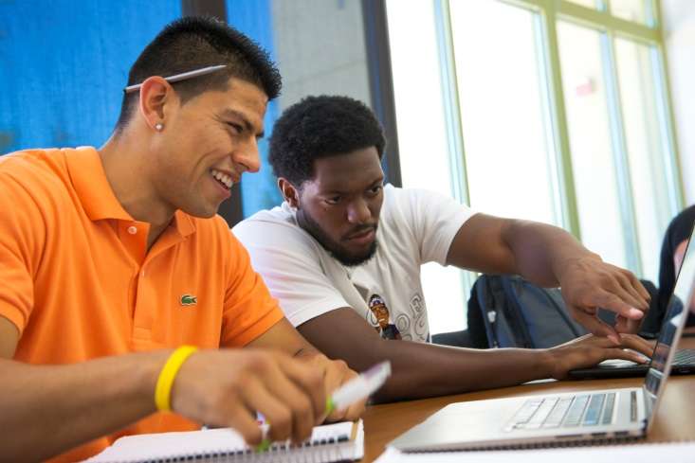

WHERE ARE THE ALUMNI NOW?
EVALUATION OF UC POSTBACCALAUREATE PROGRAMS THROUGH THE PERSPECTIVE OF ALUMNI WHO HAVE NOT MATRICULATED INTO MEDICAL SCHOOL
Karina Chavez, Darin Latimore, MD FACP, Jose Morfin MD
Office of Student & Resident Diversity I UC Davis Postbaccalaureate Program
INTRODUCTION
MATERIAL & METHODS
RESULTS
CONCLUSION
The University of California Schools of Medicine offer comprehensive postbaccalaureate programs designed to assist students from educationally and economically disadvantaged backgrounds in gaining admission to medical school. The mission is to increase the number of physicians who practice in shortage areas of California (1). These programs are offered at UC Davis, UCLA, UC Riverside, UC Irvine, and UCSF. All of them provide the preparation and skills needed to complete the MCAT, the ability to enroll full-time in upper division science courses at any of the UCs mentioned above and UC Extension, and the guidance and support to apply into medical school. Over the years, the UC postbaccalaureate programs combined have successfully been able to matriculate over 450 of its alumni. Since 1991, UC Davis School of Medicine postbaccalaureate program has served as a pipeline into medical school for 280 students. The program currently accepts 22 students each year (2). Approximately 70% of these students are identified as underserved/underrepresented in medicine: 50% Latino, 20% African American, and 0.3% Native American (3). Through a multi-dimensional approach, the program works to promote the development of active learners who can excel academically. The UC Davis School of Medicine postbaccalaureate program offers a Summer quarter on learning skills and MCAT preparation in partnership with Kaplan in addition to the full-time upper division science coursework at the main campus. They also receive active academic counseling, advising and psycho-social support through UC Davis Counseling and Psychological Services (CAPS) and comprehensive advising throughout the medical school application process. Over the years, 82% of postbaccalaureate participants have matriculated into an M.D program.
The Evaluation of UC postbaccalaureate programs is designed to help faculty and staff better understand the experience of the approximately >20% of alumni who do not matriculate into medical school. “Success” of a pipeline or enrichment program is typically measured by acceptance rates into medical school, performance on National Board Exams and clerkship evaluations (3, 4). There is currently no data in the literature that analyzes the effectiveness of a pipeline program, such as a postbaccalaureate program, through the perspective of individuals that do not continue on towards medical school. We explored and evaluated factors that may have prevented our alumni from getting accepted into medical school, with the intent of optimizing student experience and preparing them for their future career goals. We are also interested in determining how participation in our programs have benefitted students in choosing alternative careers.
UC Postbaccalaureate Programs (UC Davis, UCSF, and UC Irvine) alumni who completed the program in the years 2000-2014 at (5)
  470 (86%) matriculants: students accepted to and enrolled into an allopathic or osteopathic school of medicine
  64 (14%) non-matriculants: students identified as having not yet gained acceptance into a medical school
Recruitment Methods
  UC postbaccalaureate program directors were contacted and invited to participate in this project (UC Irvine, UC Davis, and UCSF were included)
  Eligible participants were contacted and invited to complete an on-line survey regarding their postbaccalaureate experience
  Participants were assigned a unique identifier to maintain confidentiality of personal information and responses.
Participants: 16 total non-matriculant students were interviewed
  A 30-question survey that included open-ended comments was offered via surveymonkey.com
  The survey included the ability for participants to check-off the location and year they completed the program
Overlapping themes were then generated based on participant responses
Interview Question Themes
Resources and Support
Academics & Learning Styles
Applying to Medical School & Support
Alumni Activities
Themes generated from survey
“From my background, where I am from, education is not a given. You work the fields in the Summer to help your family. It was challenging but it gave me the tools to study and succeed”
“I took the MCAT after PB, but I was almost homeless at the time, there a lot of stressors not having safety and also not knowing whether you have clothes or food. I could have done better on my verbal but I didn’t”
“The PB allowed me to believe that I was actually smart and can succeed academically! I wasn’t a B or C student, I was actually an A student and that confidence stays with you!”
“I think having the cohort and faculty keep in touch with one another more often. I think after finishing the program, it would have been helpful to have that bridge-- to keep me focused and inspired”
“After the PB, I completed PA school at Touro in Vallejo and received my Master’s in Public Health and Case Studies”
Limitations
Limited updated alumni database contact info from site
  MCAT Scores do not include most recent test changes
Small pool of eligible alumni participating in survey
  difficult to generalize results for other eligible participants
Recall and openness to response to interview questions
Theme building
  Since we did not interview matriculant students, we are unsure as to whether these themes are unique to non-matriculants
Possible Areas of Improvement
The areas in which the postbaccalaureate program can improve include the promotion of student services, such as counseling, and incorporating more support for MCAT preparation.
Mentorship during and beyond completing the postbaccalaureate program is necessary for guidance in health-related pathways.
Participants if given a choice, still aspire to become a physician. They continue to give back to their community and although they choose an alternate career path, it is still within the health field.
Despite not matriculating into medical school, they still experience an increase in self-confidence and developed leadership skills.
Consideration of Postbaccalaureate Programs evolving to include other interdisciplinary collaborative opportunities (PA/NP/Graduate programs) for its students.
Underutilization of Counseling Services
Increased Self-confidence in Current Career
Going Back to Serve the Community
Continued Involvement in Health-related Field
Academic Success & MCAT Success
Mentorship Beyond Completion of Program
Demographics of students at UC Davis postbaccalaureate program | Matriculants | Non-matriculants
Gender | 65% Female 35% Male | 67% Female 33% Male
Ethnicity | 50% Latino 19% African American 16% Asian American 6% Caucasian 5% Native American 5% Other | 44% Latino 25% African American 22% Asian American 3% Caucasian 0% Native American 6% Other
Undergraduate Institution | 75% UC 12% CSU 13% Other | 50% UC 33%CSU 8% Other
Average Undergraduate GPA | 2.99 | 2.95
REFERENCES
postbac.ucdmc.ucdavis.edu
Nimonkar, Alicia M., and Darin Latimore. "Postbaccalaureate Program Study Skills: A Multi-Dimensional Approach." UC Davis School of Medicine . AAMC West Regional Conference. 27 Apr. 2010. Lecture.
Latimore, Darin, and Alicia M. Nimonkar. "Postbaccalaureate Program Study Skills: A Multi-Dimensional Approach." AAMC Western Regional Conference. 27 Apr. 2010. Lecture.
Keith, L, and D Hollar. "A social and academic enrichment program promotes medical school matriculation and graduation for disadvantaged students." Education Health 25.1 (2012): 55-63. PubMed. Web. 12 Aug. 2013
Jackson, E W., S McGlinn, M Rainey, and H R. Bardo. "MEDPREP--30 years of making a difference." Academic Medicine 78.5 (2003): 448-553. PubMed. Web. 16 Aug. 2013.
UC Office of the President. Unpublished administrative material. Retrieved 13 Apr. 2015.
OBJECTIVES
To assess strengths, weaknesses, and areas of improvement at the UC postbaccalaureate programs
By identifying areas of improvement, we plan to create strategies that lead to higher matriculation rates into medical school for postbaccalaureate program participants
To evaluate if the postbaccalaureate program has significantly impacted alumni (who have not matriculated into medical school) to discover alternate career choices
Demographic of students completing UC Davis postbaccalaureate program | Matriculants | Non-matriculants
Average postbaccalaureate GPA | 3.66 | 3.34
Average MCAT Score | Verbal 7 Physics 8 Biology 9 Total 24 | Verbal 5 Physics 6 Biology 9 Total 18
ACKNOWLEDGEMENTS
Supported by the Office of Student and Resident Diversity at the UC Davis School of Medicine. Special thanks to Dr. Darin Latimore and Kay Holmes for their support and contributions.
Academic success & MCAT success
Underutilization of counseling services
Increased self-confidence
Going back to serve the community
Aspiration to become a physician
Continued involvement in a health-related field
Continuous faculty/staff support and follow up after completing the program
Peer awareness/support for those applying in the same medical school cycle
Allowing a broader coursework outside of medical school requirements
Academic success and MCAT success
Underutilization of counseling services
Increased self-confidence in current career
Aspiration to become a physician
Going back to serve the community
Continued involvement in a health-related field

